Slide 1
Strategic and Change Management
Presented
by
Dennis Smith - CM(SA)
12/03/16

Slide 2
The Diagnostic Process Diagnostic Models Organisational Systems Change Management strategies Basic Strategies Selecting a Change Strategy
Managing the Change Process Executing Transformation Resistance to change Causes/Lifecycle / Recognising and Managing Resistance The Importance of Process and Process Consulting

Slide 3
About Organization Development (OD)
Relatively new field of study – 50’s & 60’s
OD is about how organizations and people function and how to get them function better
Start Point – when the leader identifies an undesirable situation and seeks to change it.
Focus - Making organizations function better (total system change).
Orientation - Action (achieving results through planned activities).
No unifying theory – just models of practice
OD is an organization improvement strategy

Slide 4
Start Point
Poor alignment to organization’s strategy
Inappropriate organization structure
Low productivity
Poor quality
Poorly designed tasks
Poor morale
Organization
Intergroup conflict
Unclear goals
Organization Development
Poor team performance
Interpersonal conflicts
Inappropriate leadership style

Slide 5
Focus
Change – new state of things, different from old state of things
Can be viewed as an opportunity or as a threat
First order change
(making moderate adjustments)
Change
Second order change
(reinvent, reengineer, rewrite)
What needs to be changed and how to go about it
OD consultants are experts in organizational change

Slide 6

Orientation
Diagnosing
This process is known as
‘Action Research’
Taking Action
Three ingredients:
Participation
OD consultant (as collaborator & colearner)
Iterative process of diagnosis & action
Re-Diagnosing
Taking New Action
Change occurs based on the actions taken
New knowledge comes from examining the results of the actions.

Slide 7
The Politics of Change
Impetus for change is likely to come from outside change agents.
Internal change agents are most threatened by their loss of status in the organization.
Long-time power holders tend to implement only incremental change.
The outcomes of power struggles in the organization will determine the speed and quality of change.

Slide 8
Diagnosing Organizations

Slide 9
Some advantages of a thorough scientific organisation diagnosis .
Identifying the essential problems and needs of the organisation and ensuring that interventions are based on these identified problems and needs
Providing organisation members with an occasion to bring their ideas and feelings to the attention of top management in a material and objective way
Giving senior management a broad picture as well as detailed information on the organisation’s well-being in terms of a variety of factors which include the organisation climate and management practices, team, workgroup and departmental performance, job satisfaction and the quality of work life of employees, and……………………
finally, the extent to which organisation members feel that they are empowered and committed to their jobs Leading members to become involved in problem identification and problem- solving, thus encouraging participation, and a sense of ownership, possession and commitment

Slide 10
What is Diagnosis?
Systematic approach to understand present state of organization.
Specifies nature of problem and causes.
Provides basis for selecting strategies.
Involves systematic analysis of data.

Slide 11
Critical Issues in Diagnosis
Simplicity.
Visibility.
Involvement.
Primary factors.
Measure what’s important.
Sense of urgency.

Slide 12
Diagnosing Problem Areas (part 1 of 2)
Identification of areas for improvement.
Assess current performance and desired level of quality.
Provides information that allows for faster-reacting organization.

Slide 13
Diagnosing Problem Areas (part 2 of 2)
Analyzes data on organization’s:
Structure.
Administration.
Interaction.
Procedures.
Interfaces.
Other elements.

Slide 14
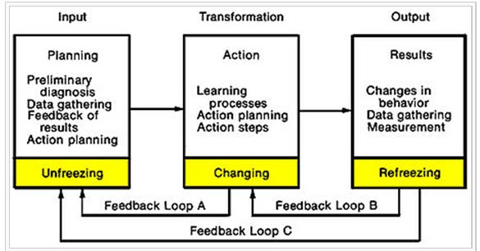
Diagnosis

Slide 15
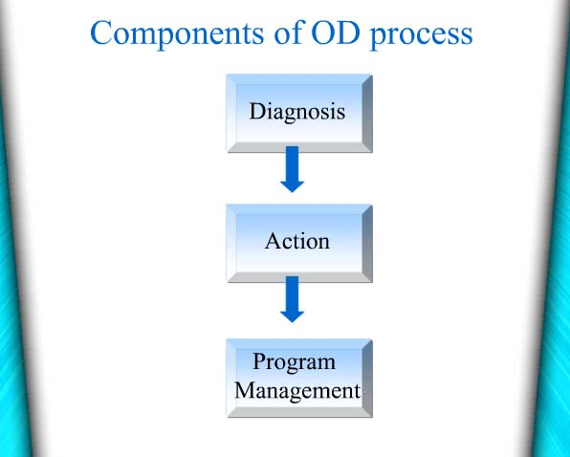
.

Slide 16
The Diagnostic Phase
The Organizational Term
to identify system parameters and recognize symptoms, problems, and causes of the organization effectiveness
The Medical Term
The act or process of finding out what disease of a person on animal has by examination and careful study of the problem.
WHY DIAGNOSIS
to identify system parameters and recognize symptoms, problems, and causes of the organization ineffectiveness

Slide 17
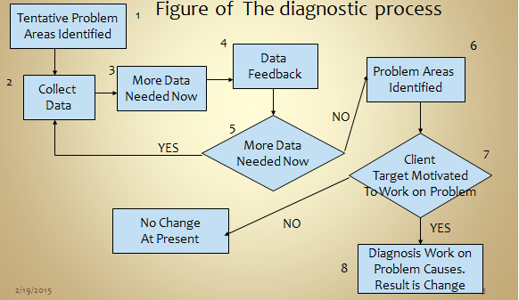
.
The Process
of Diagnosis
The process that involves data gathering, interpretations, and identification of problem and potential action programs
Figure of The diagnostic process
Analyze data

Slide 18
The Method of Diagnosis
Data-gathering method
Data acquired in a system manner, thus allowing quantitative or qualitative comparison between elements of the system
Employee Surveys
Questionnaires, interviews , orientations, feedback and etc
DIAGNOSTIC

Slide 19
Evaluating The Effectiveness Of Diagnosis
The Validity of the Data Collection
The Time to Collect Data
The Organization Culture and Norms
The Cost of Data Collect

Slide 20
.
Red Flags In The Diagnosis
The Over Diagnosis
The Confidentiality
The Crisis Diagnosis
The Threatening and Overwhelming Diagnosis
The Consultant’s Favorite Diagnosis

Slide 21
Diagnostic Models
Models may be used to:
Analyze structure, culture, and behavior of organization.
Models play a critical role.
Provide conceptual framework to understand organization.

Slide 22

Organization-Level
Diagnostic Model
Inputs
Design Components
Outputs
General
Environment
Industry
Structure
Technology
Strategy Structure
HR Measurement
Systems Systems
Organization
Effectiveness
Culture

Slide 23
Group-Level
Diagnostic Model
Inputs
Design Components
Outputs
Goal Clarity
Organization
Design
Task Structure
Team Functioning
Team Effectiveness
Group Composition
Group Norms

Slide 24
Individual-Level
Diagnostic Model
Inputs
Design Components
Outputs
Organization
Design
Group Design
Personal Characteristics
Skill Variety
Task Identity
Autonomy
Individual Effectiveness
Task Significance
Feedback about Results

Slide 25
Types of Diagnostic Models
a) The Analytical Model (difference-integration Model) emphasises the importance of a sound diagnosis as the basis for planned change in an organisation - developed to study interdepartmental issues by carrying out a diagnosis of the organisation’s problem areas.
b) The Emergent-Group Behaviour Model - complex pattern of behaviour consisting of activities, relationships, sentiments and norms - helps in understanding how teams operate and in identifying problems in the organisation.
c) The Management Practitioner Model analyses six basic areas - basic planning, general business practices of the company, advertising and promotion, market research and the personnel of the organisation.
d) The Sociotechnical Systems Model analyses the organisation as a sociotechnical system interacting with its external environment -a social system consisting of the network of interpersonal relationships and a technological system. These two systems are interrelated and interdependent. The diagnosis determines how they interrelate, placing emphasis on the feedback or lack of feedback between the various systems.
e) Cause Maps and Social Network Analysis Model - Cause maps are mathematical representations of perceived causal relationships between variables. Analysis of the causal makeup of the organisation and the specific interdepartmental relationships provide knowledge about key interdependencies

Slide 26
Differentiation-Integration Model (part 1 of 3)
Stresses sound analytical diagnosis.
Used for interdepartmental issues.
Collects data on activities, interactions, and norms.
Objective is to help departments achieve integration.

Slide 27
Differentiation-Integration Model (part 2 of 3)
Steps in implementation of model:
Begins with study of degree of differentiation between units.
Then analyzes integration and cooperation required between units.
Provides a basis for structural and cultural changes in departments.

Slide 28
Differentiation-Integration Model (part 3 of 3)
Examines work units using 4 characteristics of environment:
Degree of departmental structure.
Time orientation of members.
Interpersonal orientation of members toward others.
Members’ orientation toward goals.

Slide 29
Table 5.1 Example of Survey Results Using the Differentiation-and-Integration Model

Slide 30
Sociotechnical Systems Model
Two interrelated systems in organization:
Social system.
Technical system.
The 2 systems are interrelated.
Diagnosis determines:
Interrelationships.
Type of feedback required between subsystems.

Slide 31
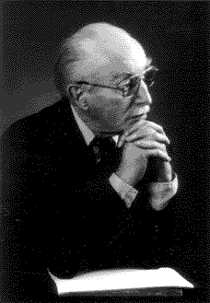
Systems Theory Contd..
Sociotechnical Systems Theory (STS)
All organizations comprised of two interdependent systems:
Social system
Technical system
Eric Trist
To achieve high productivity and employee satisfaction, organizations must optimize both systems.
Changes in one system affect the other system.

Slide 32
Causal Loop Diagram

Slide 33
Diagnosing Organizational Subsystems
Diagnostic targets | Information sought | Methods of Diagnosis
The total organization | Q) What is organization’s culture? Q) Are organizational goals and strategy understood and accepted? Q) What is organization’s performance? | Examination of organizational records – rules, regulations, policies Questionnaire survey Interviews (both group & individual)
Large and complex subsystems | Q) What are the unique demands on this subsystem? Q) Are organization structures and processes related to unique demands? Q) What are the major problems confronting this subsystem? | Questionnaire survey Interviews Observations Organization records
Small and simple subsystem | Q) What are major problems of the team? Q) How can team effectiveness be improved? Q) Do individuals know how their jobs relate to organizational goals? | Individual interviews group meeting to review the interview data Questionnaires Observation of staff meetings and other day- to-day operations
Intergroup subsystems | Q) How does each subsystem see the other? Q) What problems do the two groups have in working together? Q) How can they collaborate to improve performance of both groups? | Interviews of each subsystem followed by ‘sharing the data meeting’ Flowcharting critical processes Meetings between both groups
Individuals | Q) Do people perform according to organization’s expectations? Q) Do they need particular knowledge or skills? Q) What career development opportunities do they have/ want/ need? | Interviews Information from diagnostic meetings Data available with HR department
Roles | Q) Is the role defines adequately? Q) What is the ‘fit’ between person and role? Q) Is this the right person for this role? | Role analysis Observations Interviews

Slide 34
Diagnosing Organizational Processes
Organizational Processes | Information sought | Methods of Diagnosis
Communication patterns, styles & flows | Q) Is communication open or closed? Q) Is communication directed upward, downward, laterally? Q) Are communications filtered? ….. Why? How? | Observations – in meetings Questionnaires Interviews and discussion with group members
Goal setting | Q) Do people set goals? Q) Who participates? Q) Do they possess necessary skills for effective goal setting? | Questionnaires Interviews Observations
Decision making, problem solving & action planning | Q) Who makes decisions? Q) Are they effective? Q) Are additional decision making skills needed? | Observations of problem-solving meetings Analysis of videotaped sessions Organizational records
Conflict resolution and management | Q) Where does conflict exist? Q) Who are involved parties? Q) How is it being managed? | Interviews Flowcharting critical processes Meetings between both groups
Superior-subordinate relations | Q) What are the prevailing leadership styles? Q) What problems arise between superiors and subordinates? | Questionnaires Interviews
Strategic management & long range planning | Q) Who is responsible for ‘looking ahead’ and making long term decisions? Q) Do they have adequate tools and support? Q) Have the recent long range decisions been effective? | Interviews of key policy makers Group discussions Examination of historical records

Slide 35
Warning Signs in Diagnosis
Confidentiality of data.
Over-diagnosis.
Crisis diagnosis.
Threatening and overwhelming diagnosis.
Practitioner’s favorite diagnosis.
Diagnosis of symptoms, not problems.

Slide 36
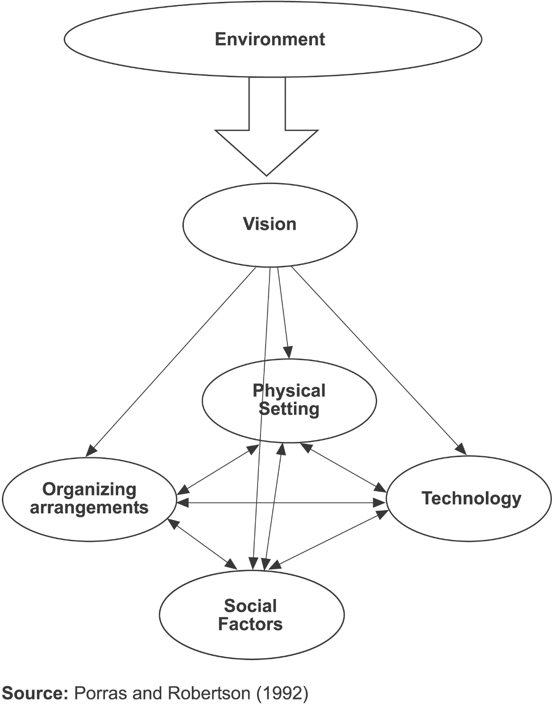
Models and theories Contd..
Organizing arrangements
Goals, strategies, structure, policies, procedures
Social Factors
Culture, management style, informal networks, individual attributes
Physical Settings
Space configuration, physical ambiance
Technology
Machinery, tools, IT, job design

Slide 37

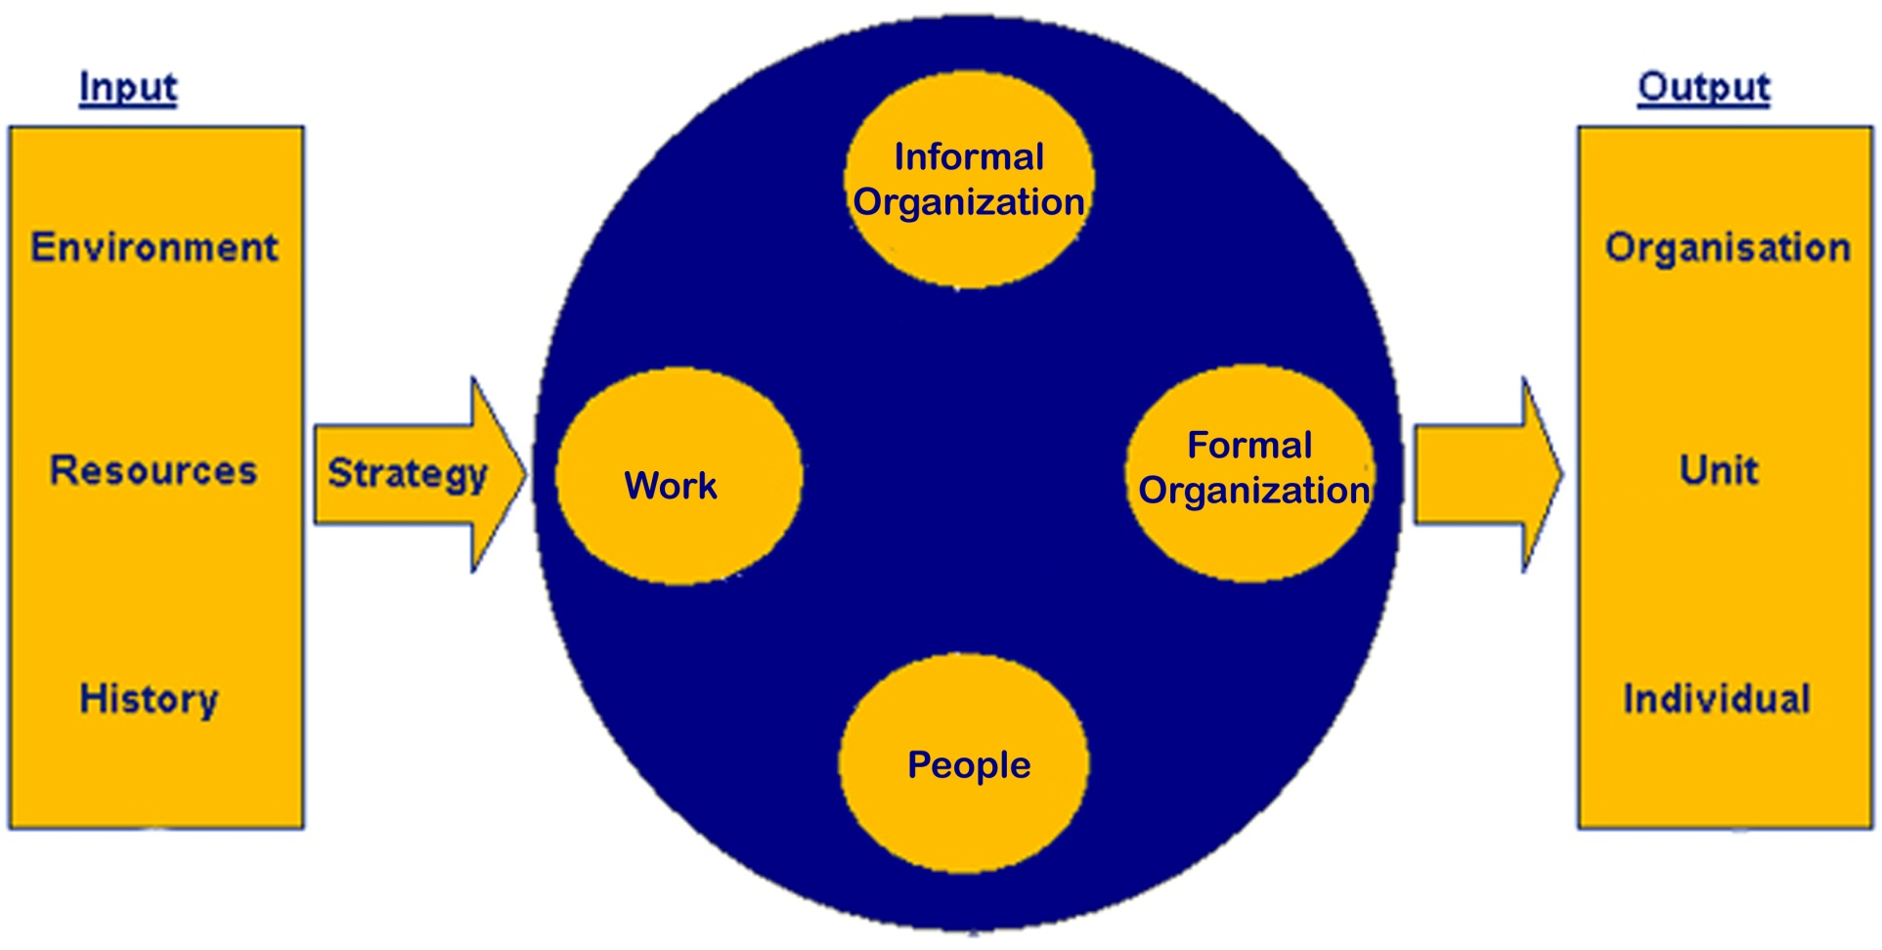
Systems Theory
Organizations are open systems in active exchange with their environment
David A. Nadler
The Congruence Model

Slide 38
Future Shock and Change
Too much change in too short a time.
Inability to adapt to accelerating rates of change.
Management reaction to change strained.
Managers must be adaptable and flexible.

Slide 39
Context for Applying Change
HIGH PERFORMANCE LEVELS
Leadership
Policies
Philosophies
Style
People
Diversity Management
Optimal performance
Development
Strategy
Shared Vision
Corporate Culture
Values
Leverage
Systems
Planning
Communication
Information Management
Quality Assurance
Finance
Structure
Communication
Control
Power
Flexibility
Teams
Conducive corporate climate and environment

Slide 40
Strategies For Change Management
Empirical­ Rational
People are rational and will follow their self -­interest once a change is revealed to them.
Change is based on the communication of information and the proffering of incentives.
Normative­ -Reductive
People are social beings and adhere to cultural norms and values.
Change is based on redefining and reinterpreting existing norms and values, and developing people’s commitments to new ones
Power­ - Coercive
People are basically compliant and will generally do what they are told or can be made to do. Change is based on the exercise of authority and the imposition of sanctions.
Environmental­ Adaptive
People oppose loss and disruption, but they adapt readily to new circumstances. Change is based on building a new organization and gradually transferring people from the old one to the new one

Slide 41
Strategies For Change Management
Degree of Resistance: Strong resistance argues for a coupling of power-coercive and environmental - adaptive strategies. Weak resistance or concurrence argues for a combination of rational-empirical and normative-reductive strategies.
Target Population: Large populations argue for a mix of all four strategies, something for everyone so to speak.
The High Stakes: High stakes argue for a mix of all four strategies. When the stakes are high, nothing can be left to chance.
Time Frame: Short time frames argue for a power-coercive strategy. Longer time frames argue for a mix of rational-empirical. Normative- reductive, and environmental-adaptive strategies.
Expertise: Having adequate expertise in making change argues for a mix of the strategies outlined in the table above. The absence of expertise results in reliance on the power-coercive strategy.
Dependency: This is a classic double-edged sword. If the organisation is dependent on its people, management’s ability to command or demand is limited. Conversely, if people are dependent upon the organisation, their ability to oppose or resist is limited (Mutual dependency almost always signals a requirement for some level of negotiation).

Slide 42
Lewin’s Three-Step Change Model
Unfreezing Change efforts to overcome the pressures of both individual resistance and group conformity.
Refreezing Stabilizing a change intervention by balancing driving and restraining forces.
Driving Forces Forces that direct behavior away from the status quo.
Restraining Forces Forces that hinder movement from the existing equilibrium.

Slide 43
Kurt Lewin’s Change Model
Proposed by K. Lewin (1958) for implementing change in an organization through 3 stages:
Change
Unfreezing
Organizational culture
Re-freezing
Organizational culture

Slide 44
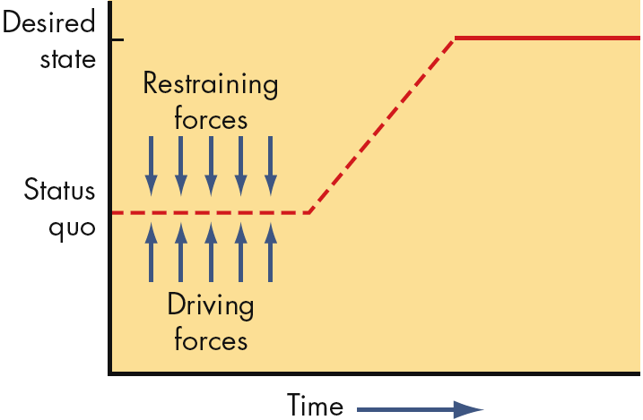
Unfreezing the Status Quo
E X H I B I T 18–4

Slide 45
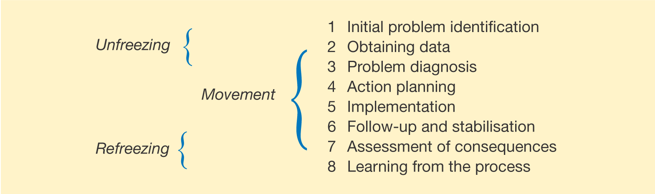
Stages in planned change
Figure 22.4
Source: Adapted from French, W.L., Kast, F.E. and Rosenzweig, J.E. Understanding Human Behaviour in Organizations, Harper and Row (1985) p.9.

Slide 46
THE 3-STEP MODEL
The basic idea was that change toward a higher level of group performance is frequently short lived. After some time, group behaviour may revert to the previous pattern.
This indicates that it is not enough to define change as a target and to stop. It is important to include also the group performance in the new state of change.

Slide 47
Unfreezing
At this stage, the forces, which maintain the status quo in the organizational behavior, are reduced by refuting the present attitude and behavior to create a perceived need for something new. It is facilitated by environmental pressure such as increased competition, declining productivity and performance, felt need to improve the style of work, etc
Moving/changing
This stage involves a shift in behavior of organizations by modifying system, process, technology and people. This phase can be explained in terms of compliance, identification and internalization (Rao and Hari Krishna 2002).
Compliance or force occurs when individuals are forced to change whether by reward or by punishment.
Internalization occurs when individuals are forced to encounter a situation that calls for new behavior.
Identification occurs when individuals recognize one among various models provided in the environment that is most suitable to their personality
Refreezing
At this stage, actions are taken to sustain the drive for change and to facilitate the institutionalization process of the change even in a day­-to­-day routine of the organizations. Here, the desired outcomes are positively reinforced and extra support is provided to overcome the difficulties

Slide 48
PHASES OF PLANNED CHANGE
The concept of planned change implies that an organization exists in different states at different times and that planned movement can occur from one state to another.
For planned change it is important to understand not only the change but also the states through which the organization must pass.

Slide 49
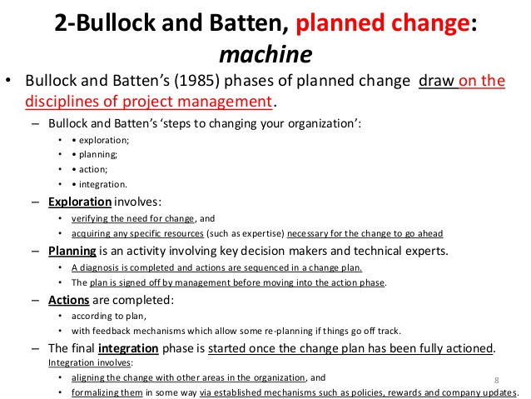

Slide 50
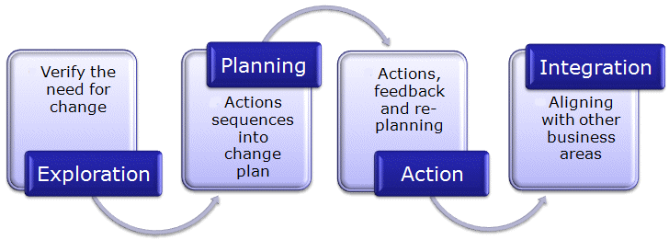

Slide 51
LIMITATIONS (I)
The basic hypothesis that an organization exists in different states at different times and that planned change is a transition from one state to another
The dynamics of business environment imposes organizational change to be more a continuous and open-ended process, than a set of discrete and self-contained events

Slide 52
LIMITATIONS (II)
Its emphasis on incremental change and its inability to incorporate radical, transformational change
It assumes that one type of approach to change is suitable for all organizations, all situations and all times
Turbulent times demand different responses in varied circumstance

Slide 53
Action Research
Action Research
A change process based on systematic collection of data and then selection of a change action based on what the analyzed data indicate.
Process Steps:
Diagnosis
Analysis
Feedback
Action
Evaluation
Action research benefits:
Problem-focused rather than solution-centered.
Heavy employee involvement reduces resistance to change.

Slide 54
Mastering Change: It’s Culture-Bound
Questions for culture-bound organizations:
Do people believe change is even possible?
How long will it take to bring about change in the organization?
Is resistance to change greater in this organization due to the culture of the society in which it operates?
How will the societal culture affect efforts to implement change?
How will idea champions in this organization go about gathering support for innovation efforts?

Slide 55
Kotter’s Eight-Step Plan for Implementing Change
Establish a sense of urgency by creating a compelling reason for why change is needed.
Form a coalition with enough power to lead the change.
Create a new vision to direct the change and strategies for achieving the vision.
Communicate the vision throughout the organization.
Empower others to act on the vision by removing barriers to change and encouraging risk taking and creative problem solving.
Plan for, create, and reward short-term “wins” that move the organization toward the new vision.
Consolidate improvements, reassess changes, and make necessary adjustments in the new programs.
Reinforce the changes by demonstrating the relationship between new behaviors and organizational success.
E X H I B I T 18–5
Source: Based on J. P. Kotter, Leading Change (Boston: Harvard Business School Press, 1996).

Slide 56
Managing the Change Process
Transformation Skills
Fombrun (1994) points out that managers responsible for spearheading the transformation process require the following skills:
Ability to shape a viable future for the organisation.
Ability to mobilise employees and key stakeholders behind the vision.
Ability to guide the organisations different systems towards the achievement of the stated vision.
Successful “selling” of the transformation agenda and having people “buying-in” results in their active participation, coalition building and effective communication flows.
However, the downside risks of mismanaging the process include isolating employees thereby creating resentment, emotional hostility, resistance and sabotage

Slide 57
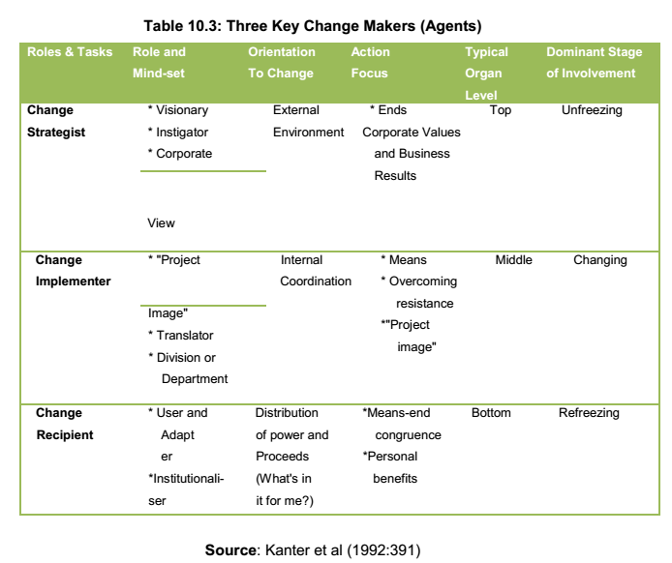

Slide 58
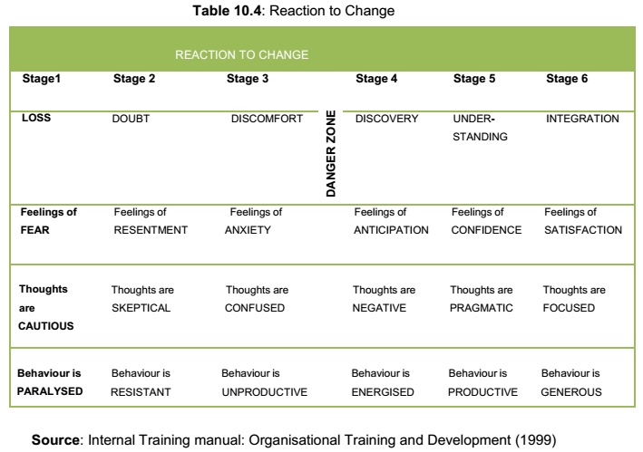

Slide 59
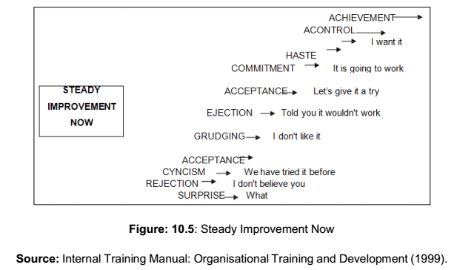

Slide 60
Executing Transformation: Tactics and Methods of Intervention
The execution of transformation can be approached in a number of ways depending on the circumstances. The following sequential steps are suggested
Analyse the Organisation and its Need for Transformation/ Strategic Change operations / environment / SWOT / effect of proposed changes Revolutionary changes are increasingly forcing organisations to restructure, reposition and redefine their boundaries
Create a Shared Vision and Common Direction Articulating the desired future state / Creating an “organisational dream / Creating an ambitious vision
consensus of views

Slide 61
Create a Sense of Urgency
Create the Conditions for Successful Transformation
Make people aware of the pressures for change - regular meetings - competitive t pressures and the performance.
Develop enabling structures that facilitate and reinforce the transformation process. -scheduled workshops, training programs and creation of new structures and reward systems -symbolic changes
Give regular feedback on the performance of individual functions and areas within the organisation -discrepancy between actual performance and desired present and future performance.
Publicise successful change.
Understand people’s fears and concerns -involve people in the transformation process in order to promote understanding and overcome potential resistance.
Communicate, involve people and be honest. This involves establishing regular and effective communication processes that provide the context for, and details and consequences of, the transformation programme

Slide 62
Craft an Implementation Plan
what needs to be done, when and how it is to be done.
Reinforce and Institutionalise the Transformation
Provide (financial and human) resources for change. Give support to change agents. Develop new competencies and skills— offer more training and coaching. Reinforce desired behaviour- link rewards such as bonuses to particular types of activity or progress. Recognise top performers. Shape and reinforce a new culture that fits with the revitalised organisation

Slide 63
Checklist for Managing Change
The first thing to do is to jump in. You cannot do anything about it from the outside. A clear sense of mission or purpose is essential. The simpler the mission statement, the better.
Build a team. “Lone wolves” have their uses, but managing change is not one of them. On the other hand, the right kind of a lone wolf makes an excellent temporary team leader.
Maintain a flat organisational team structure and rely on minimal and informal reporting requirements. Pick people with relevant skills and high energy levels. You will need both.

Slide 64
Toss out the rulebook. Change, by definition, calls for a configured response, not adherence to prefigured routines. Shift to an action-feedback model. Plan and act in short intervals.
Set flexible priorities. You must have the ability to drop what you are doing and attend to something more important. Treat everything as a temporary measure. Do not “lock in” until the last minute. Insist on the right to change your mind.
Ask for volunteers. You will be surprised at who shows up. You will be pleasantly surprised by what they can do.
Find a good “straw boss” or team leader and stay out of his or her way.

Slide 65
Give the team members whatever they ask for except authority. They will generally ask only for what they really need in the way of resources. If they start asking for authority that is a signal they are headed toward some kind of power-based confrontation and that spells trouble. Nip them in the bud!
Concentrate dispersed knowledge. Start and maintain an issues logbook. Let anyone go anywhere and talk to anyone about anything. Keep the communication barriers low, widely spaced, and easily hurdled. Initially, if things look chaotic, relax — they are.
Remember, the task of change management is to bring order to a messy situation and not to pretend that it is already well-organised and disciplined.
Nickols’ suggested approach to change management appears more like “rule of thumb” that comes from a practitioner. However, it must be noted that he reduces the planning stage’s importance by recommending many short-term successive and progressive plans.

Slide 66
Critical Success Factors for Change – (Carney 2001)
Critical success factors
Communications issues
Change dynamics — resistance to accept change
Variables related to the management of the implementation process
Evaluation stages of the change process.
These five factors need to be managed if a change process is to be successful.

Slide 67
The Success Factors
These must be in place prior to success being guaranteed. They include:
Commitment of all levels (managers and staff)
Level of motivation
Use of professional judgment throughout the process
Level of understanding for the need for change demonstrated by staff Identifiable communication skills
Recognition of the need for a high quality outcome to change

Slide 68
Communication Process
Key variables include:
Consultation Education
Participation during the process
Needs of staff and clients are recognised
Negotiation with the decision makers
An understanding of the change dynamics that exist
Democratic decision making in order to reduce resist

Slide 69
Acceptance and Management of Resistance to Change
Key variables include:
Level of acceptance of the change
Involvement and understanding of the need for change
Likely impact of the proposed change on the social and cultural lives of the individuals concerned
A clear understanding of the need for a project team
Resistance to change should be managed

Slide 70
Change Implementation Process
Key variables include:
Need for prior research Project team interacting and working well together
Use of process tools. e.g. strategic development and planning with clear inputs and outputs identified
Recognition and management of the transition state (with provision of the required education programme for staff to facilitate successful implementation)

Slide 71
Evaluation Process
Key variables include:
Recognition of the need to evaluate the process at various stages
Taking necessary action
Provision for feedback Recognition and acknowledgement of the contribution of staff

Slide 72
RESISTANCE TO CHANGE
Resistance is a fact of human nature. Robbins and Finley (1998:102) describe it as an ancient pattern which broadly models the following steps:
A good idea creates an aura of hope.
Hope inspires some people but causes others anxiety.
Anxiety prompts resistance.
Resistance wrecks the good idea.

Slide 73
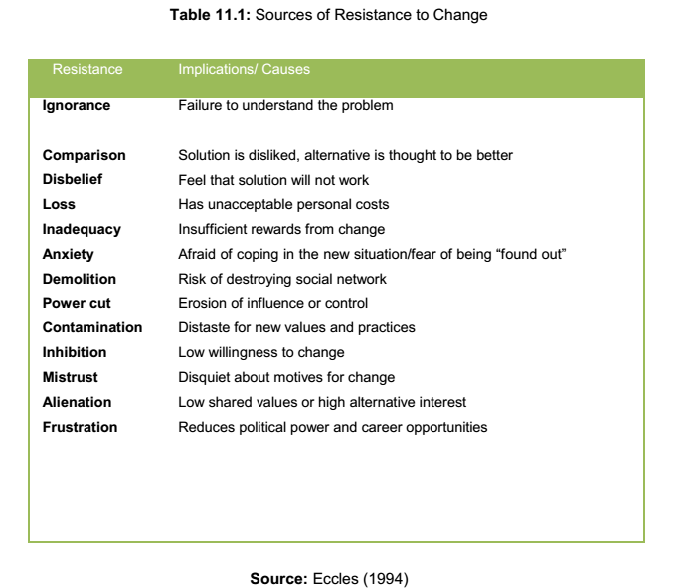

Slide 74
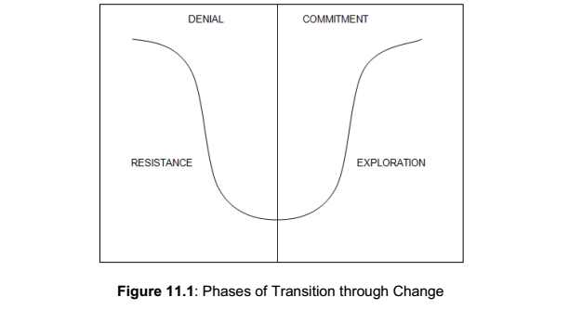

Slide 75
Strategies for Recognising and Managing Resistance
Denial
Observed behaviour: Withdrawal, “business as usual”, dwelling on the past, lots of activity but not much gets done.
Checklist: it will be over real soon - apathy - numbness
Management Strategy:
Confront individuals with information and let them know that the change will happen.
Explain what to expect and suggest actions they can take to adjust to the change.
Give them time to let the impact sink in and then conduct regular planning sessions to involve all levels.

Slide 76
Resistance
Observed behaviour: Anger, blame, anxiety, depression, and drastic productivity drop “what’s the difference, this company doesn’t care anymore.”
Checklist: cannot sleep at night - anger and fights - withdrawal from the team - gave my all and look what it got me
Management Strategy:
Listen, acknowledge feelings, and respond with empathy and support.
Don’t try to talk people out of their feelings, or tell them to pull themselves together.
Accept their response and they will continue to tell you how they are feeling, which will help you address their concerns

Slide 77
Exploration
Observed behaviour: Over preparation, confusion, chaos, energy. “Let’s try this and what about this . . .” Lots of energy and new ideas but a lack of focus.
Checklist: over-preparation frustration - too many new ideas - have too much to do - cannot focus
Management Strategy:
Focus on priorities and provide any needed training.
Follow up on projects underway.
Set short term goals.
Conduct brainstorming, visioning and planning sessions

Slide 78
Commitment
Observed behaviour: Employees begin to work together. There is co-operation, and a better focus. “How can we work on this?” Those who are committed are looking for the next challenge.
Checklist: teamwork satisfaction clear focus and plan
Management Strategy:
Set long term goals.
Concentrate on team building.
Create a mission statement.
Validate and reward those responding to the change.
Look ahead.

Slide 79
The Importance of Processes
Most productive companies in the world relied on six common success traits (Tichy & Sherman, 1993):
They managed processes rather than people. Instead of emphasising how much they produced, they focused on how they produced.
They used process mapping to spot opportunities for improvement. (Process mapping is a matter of writing down every single step, no matter how tiny, in a particular task).
They emphasised continuous improvement, and lauded incremental gains.
They relied on customer satisfaction, and not internal objectives, as the main gauge of performance.
They stimulated productivity by introducing a constant flow of high-quality products designed for efficient and easy manufacturing.
They treated their suppliers as partners, not adversaries.

Slide 80
Process Consulting
Process consultation is, according to Schein (1998:11),
“. . . a set of activities on the part of the consultant that helps the client to perceive, understand, and act upon the process events that occur in the client’s environment in order to improve the situation as defined by the client”.
Schein (1988: 1) said process consultation lies at the foundation of meaningful consultancy and is
“. . . the key philosophical underpinning to organisation development in that most of what the consultant does in helping organisations is based on the assumptions of process consultation. Understanding such assumptions is therefore critical to understand the broader concept of organisation development

Slide 81
The Underlying Assumptions of Process Consultation
The seven main assumptions that underlie process consultation were identified by Schein (1988: 10-11) as the following:
Clients often do not know what is wrong and need special help in diagnosing what their problems actually are.
Clients often do not know what kinds of help consultants can give to them. They need to be helped to know what kinds of help to seek.
Most have a constructive intent to improve things, but they need help in identifying what to improve and how to improve it.
Most organisations can be more effective than they are if they learn to diagnose and manage their own strengths and weaknesses. No organisational form is perfect, hence every form of organisation will have some weaknesses for which compensatory mechanisms must be found.

Slide 82
5. A consultant probably cannot, without exhaustive and time-consuming study or actual participation in the client organisation, learn enough about the culture of the organisation, to suggest reliable new courses of action. Therefore, unless remedies are worked out jointly with members of the organisation who do know what will and will not work in their culture, such remedies are likely either to be wrong or to be resisted because they come from an outsider.
6. Unless the client learns to see the problem for himself and thinks through the remedy, he will not be willing or be able to implement the solution and, more importantly, will not learn how to fix such problems should they recur. The process consultant can provide alternatives, but decision-making about such alternatives must remain in the hands of the client.
7.The essential function of the process consultant is to pass on the skills of how to diagnose and fix organisational problems so that the client is more able to continue on his own to improve the organisation.

Slide 83
Process Interventions and Group Processes
There are a number of specific relationship building techniques that the process consultant may want to consider at the inception and during the process of the consulting procedure. These may include:
Person-consultant Balance Consulting effectiveness is a matter of balance. It is maximal when the consultant can relate to clients in a warm and understanding way on the one hand, and can display technical competence in interpretation, information giving, and application of sound methods, on the other.
Spontaneity Consulting is not a rigid mechanical application of methods and techniques for producing behaviour changes. The consultant must be free to move naturally, quickly, and easily in his thinking and activity to adapt to nuances of the client's behaviour and needs.
Acceptance Acceptance manifests itself in a non-judgemental attitude which recognises the client’s right to make his or her own decisions and which believes in the client’s capacity to choose wisely and responsibly. Conversely, acceptance is not blanket approval or agreement; neither is it neutrality, sympathy, or tolerance

Slide 84
Understanding and Empathy There are two aspects to the concept of understanding: understanding diagnostically refers to the intellectualised description of the client’s behaviour and processes, while understanding therapeutically is the ability of the consultant to enable the client to feel understood, accepted, and empathised with. Empathy is the ability of the consultant to think with, rather than for or about the client. In other words, it is the ability of the consultant to assume the client’s internal frame of reference.
Warmth and Consideration Warmth encompasses the sensitive, friendly, considerate and responsive elements of the consultant’s personality. “Relating easily to people” is a term often used to describe this ability. Consideration for the client is rooted in respect for him as a person so that he feels important and worthwhile.
Freedom A corollary to acceptance and non-judgemental attitudes is the consultant who says in effect, “You may discuss anything you wish here without fear of judgement.”
Flexibility The consultant must be skilled and able to move easily and quickly from one role to another and to move along the dimensions of the various techniques and methods that are defined by Harvey and Brown (2006)
Transparency In order to elicit open and honest self-diagnosis on the part of the client, the consultant must himself manifest these qualities. In much social communication, both parties keep up a front and so conversation is often a game of mild deceit. Once the client experiences a relationship where the deceit is not present, he realises he can drop the facade and speak frankly

